Slide 1
Nuclear Fuel Performance
NE-533
Spring 2024

Slide 2
Last Time
In-pile release Booth model
Forsberg-Massih 2-stage FGR model
Three component diffusion
Swelling/dimensional change
densification, thermal expansion, solid/gas fission product swelling, creep
Fuel fracture

Slide 3
Zirconium Cladding

Slide 4
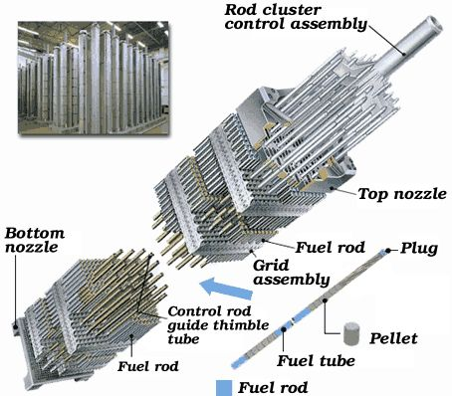
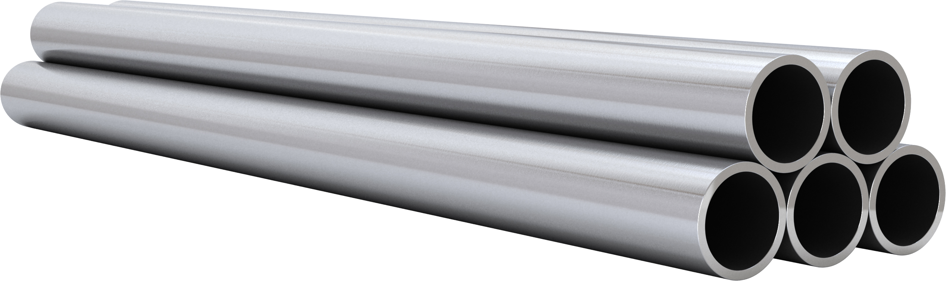
Cladding
The purpose of the cladding is to:
Hold the pellets together so that coolant can freely flow past
Transport heat from fuel to the coolant
Contain fission products
Contain fuel fragments
We would also prefer if the cladding had little to no impact on the neutron transport in the reactor

Slide 5
Why Zirconium alloys?
Benefits
Low neutron cross section
Corrosion resistance in 300˚C water
Resistance to void swelling
Adequate mechanical properties
Good thermal conductivity
Affordable cost
Available in large quantities
Problems?
Corrosion under high temperature steam
Hydride embrittlement
Anisotropic characteristics lead to creep and growth

Slide 6
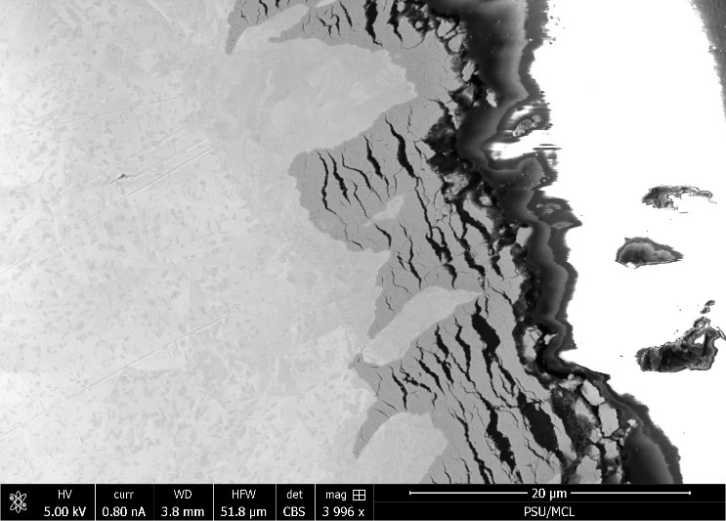
Zirconium
Pure zirconium was not acceptable due to its oxidation behavior
Oxygen with water reacted to form an oxide layer
The oxide layer is brittle and flakes off, allowing more oxidation to occur
Zr alloys were developed to improve corrosion resistance

Slide 7
Commercial Zr Alloys in PWRs
Alloy | Sn % | Nb % | Fe % | Cr % | Ni % | O %
PWRs (structural components and fuel rods)
Zircaloy-4 (SRA) | 1.2-1.7 | - | 0.18-0.24 | 0.07-0.13 | - | 0.1-0.14
ZIRLO (SRA) | 1 | 1 | 0.1 | - | - | 0.12
Optimized ZIRLO (pRXA) | 0.7 | 1 | 0.1 | - | - | 0.12
M5 (RXA) | - | 0.8-1.2 | 0.015-0.06 | - | - | 0.09-0.12
HPA-45 (SRA/RXA) | 0.6 | - | Fe+V | - | - | 0.12
NDA (SRA) | 1 | 0.1 | 0.3 | 0.2 |  | 0.12
MDA (SRA) | 0.8 | 0.5 | 0.2 | 0.1 |  | 0.12
PRXA Partial Recrystallization Anneal
RXA Recrystallization Anneal
SRA Stress-Relief Anneal

Slide 8
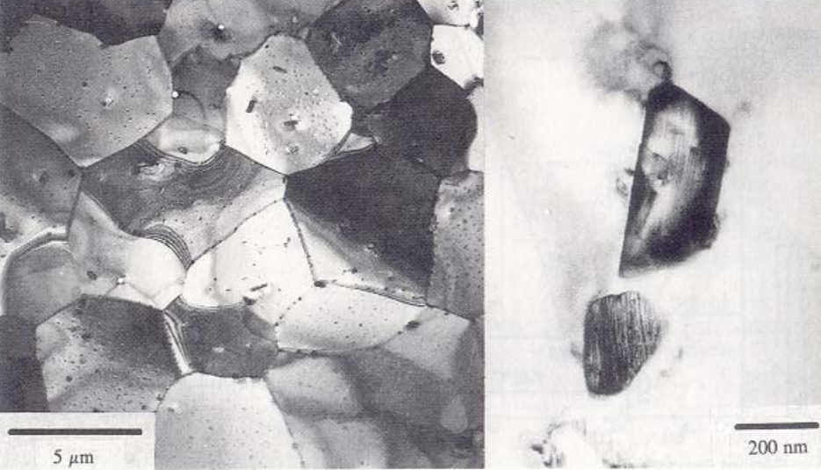
Alloying Elements
The alloying elements impact the microstructure of the material
The intermetallic precipitates significantly improve the oxidation behavior
In Zircaloy 2, the precipitates are
Zr(Cr, Fe)₂
Zr₂(Ni, Fe)
In Zircaloy 4, the precipitates are
Zr(Cr, Fe)₂
Phosphides (Zr₃P) and silicides (Zr₃Si) are also occasionally found
The precipitate distribution, size, morphology, and composition all impact the properties of the material

Slide 9
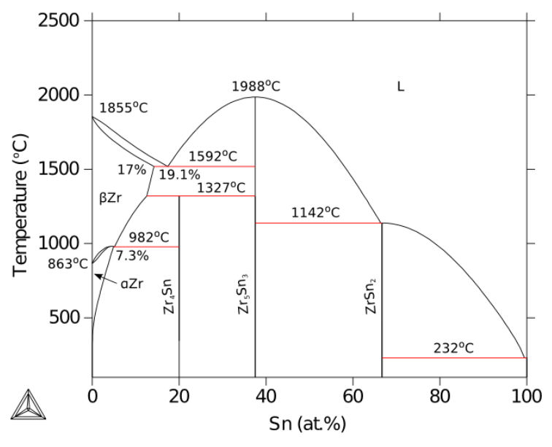
Zirconium Phases
The α-Zr phase has a hexagonal-close-packed (HCP) structure
At temperatures below about 863ºC
Has the most desirable properties
The β-Zr phase has a body-centered cubic (BCC) structure
We try to avoid this phase

Slide 10
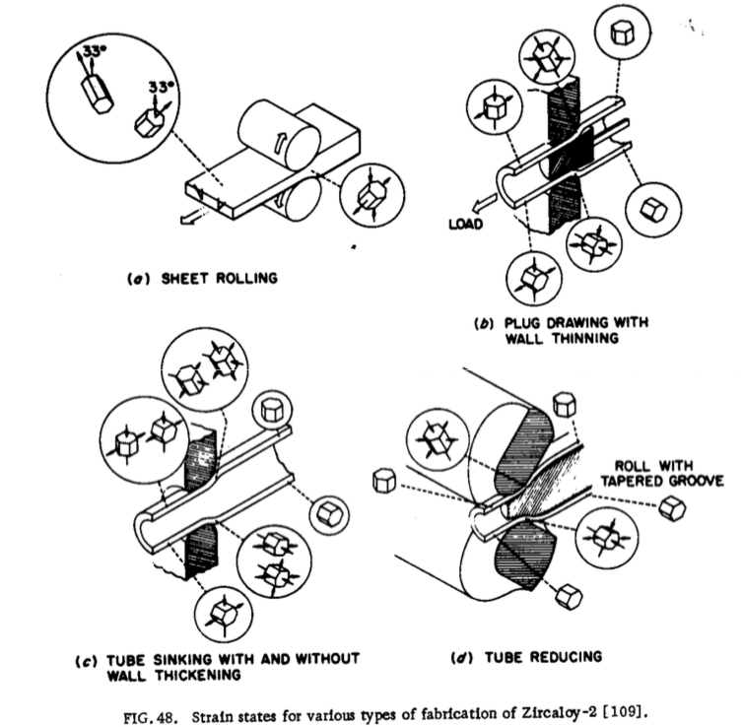
Zr Tube Fabrication
The cladding tubes are fabricated using various processes that SEVERELY deform the material
The severe plastic deformation causes significant dislocation hardening, that can make the tube material too brittle
Plastic deformation along slip planes results in reorientation of the grains
The properties of the material are controlled by heat treatment
Raising the temperature, but below 863˚C, anneals the sample to reduce cold work (stress-relieved)-SRA
Raising the temperature above 863˚C changes to the β phase. They then quench the sample to create a random texture in the α phase-RXA or pRXA

Slide 11
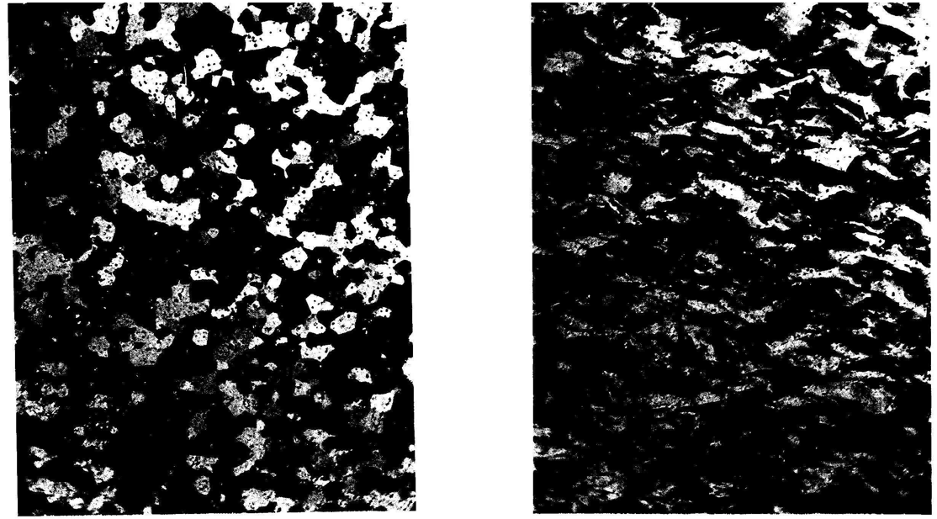
Zr alloy microstructures
Fully recrystallized after quench
Stress-relieved microstructure

Slide 12
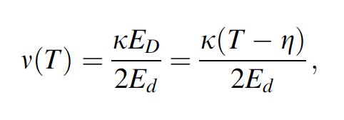
Zirconium Creep and Growth
The cladding undergoes a very large amount of irradiation during its life, the main effects are:
Interstitial loops form on prismatic planes
Later in the reactor exposure, vacancy loops form on the basal plane
The overall number of displacements to the cladding can be calculated with the NRT model to be ~ 8 x 10⁻⁸ dpa/s, which, over 3 years exposure gives a total of ~8 dpa (every atom in the solid is displaced on the average eight times)

Slide 13
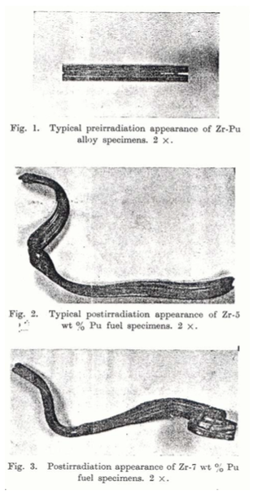
Irradiation Growth
Irradiation growth results from material anisotropy
There is corresponding anisotropy in the defect behavior within the unit cell
There is also a texture formed in the grain orientations
Interstitial loops form on pyramidal planes, causing shrinkage along the center axis
Later, vacancy loops form on basal planes, making it even worse
The result is a change in shape, shrinking in the 0001 direction and expanding in the pyramidal direction

Slide 14
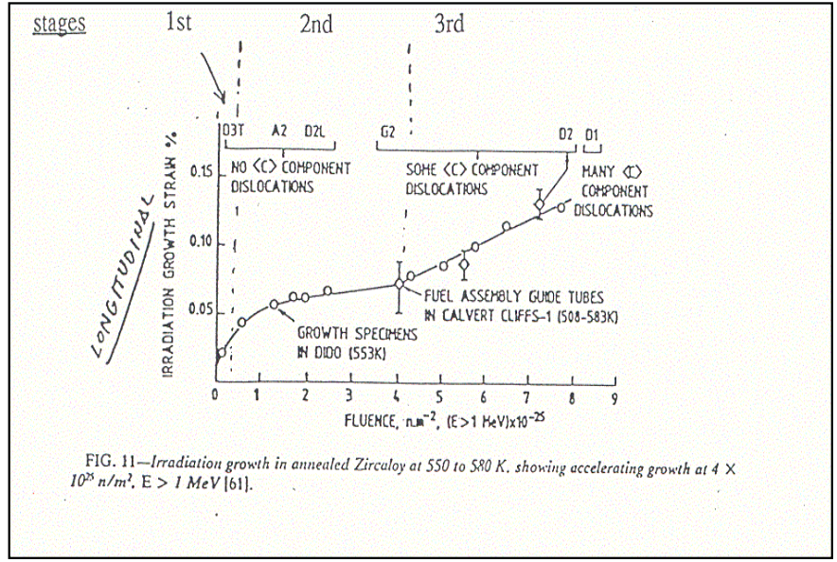
Irradiation Growth
Three stages of irradiation growth
Initial rapid growth to small strains – defect generation
Slow growth – defect accumulation, gets skipped in cold worked material
Accelerated or breakaway growth, caused by formation of vacancy loops on the basal plane
Irradiation growth is affected by:
Fluence, Cold work, Texture, Irradiation temperature, Material chemistry, Hydrogen effects

Slide 15
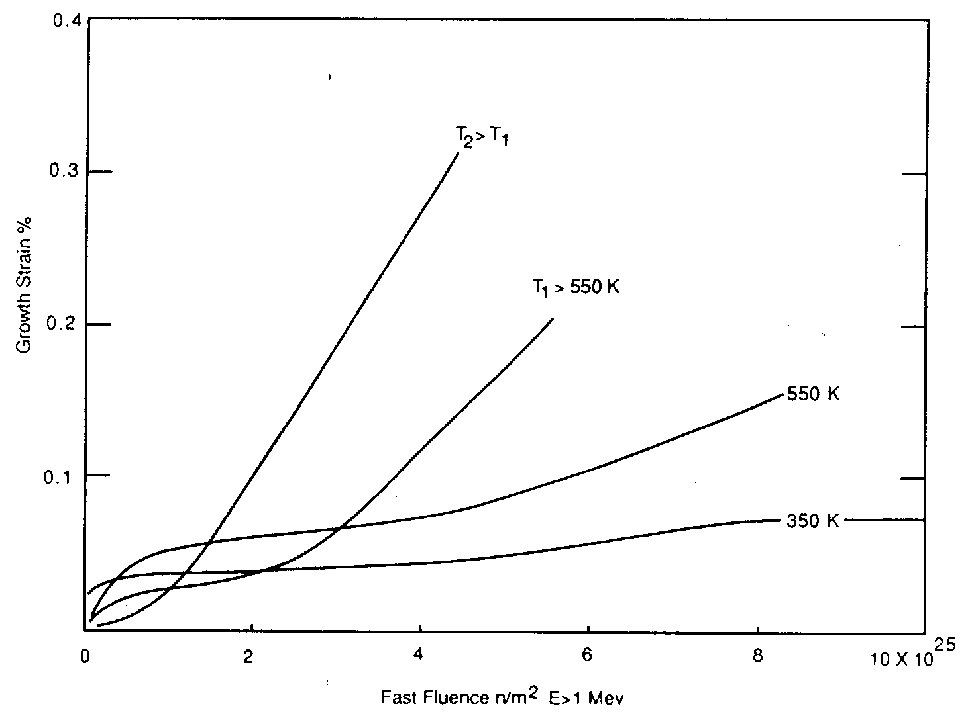
Irradiation Growth
Higher temperature leads to earlier breakaway and higher growth
Higher temperature adds mobility to defects, allowing them to diffuse faster, form clusters, and exacerbate the defect cluster induced anisotropic growth

